Slide 2
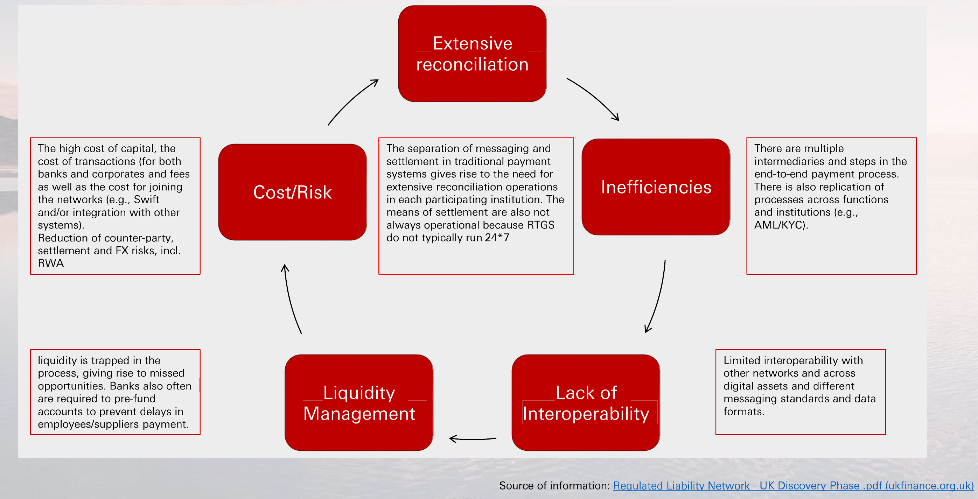
What Problem is RLN Solving

Slide 3
RLN timeline
BoK
BdF
Brazil
16 May 2023
https://aprendervalor.bcb.gov.br/en/about/events/67
Microsoft
https://www.bcb.gov.br/conteudo/eventos/Documents/moedas_digitais/tokenizacao/WorkTOK-Mimeo-TECH_Multi_B_Proposal_RLN_architecture_to_support_Settlement_of_tokenized_assets_liabilities_transactions.pdf
An article from Microsoft, "Proposal of a Regulated Liabities Network(RLN) architecture to support settlement of tokenized assets, liabilities and transactions using tokenized deposits and wholesale CBDC (Real Digital).", with an implementation proposal for the future Brazil CBDC was selected in Technology category in the Workshop “The tokenization of finance: from crypto assets to central bank digital currencies” held by Brazil Central Bank. Mircosoft is also selected to be one of the participant for the Brazil CBDC implementation on Jul2023

Slide 4
RLN Website

Slide 5
RLN Vendor
Vendor , involvement, technology, whitepaper
Add Microsoft

Slide 6
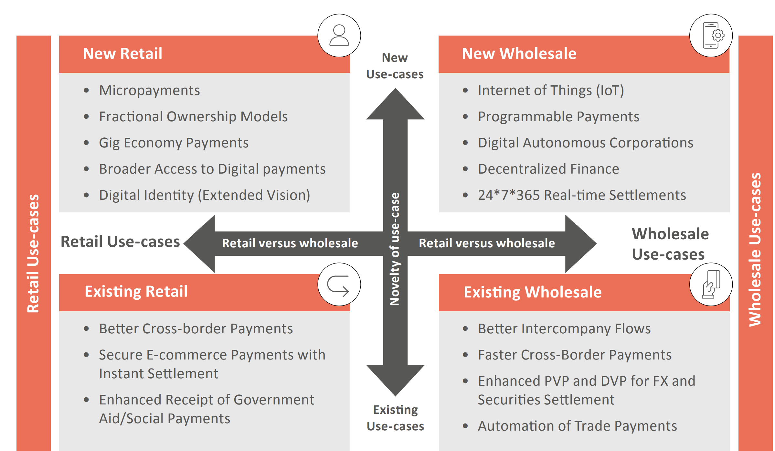
RLN Use case
The RLN would be designed to support the same use-cases as account-based “regulated liabilities” but with the enhanced functionality of programmable, always-on digital money offering “on-chain” finality of settlement.
Ref: Regulated Liability Network

Slide 7
Use case 1: Domestic interbank payment

Slide 8
Use case 2 – Cross Border payment
Same Structure,
Foreign institution in the same network

Slide 9
Use case 3 Domestic DvP Payment

Slide 10
Use case 4 PvP/ FX/AMM

Slide 11
Comparison with Unified Ledger
 | Regulated Liability Network | Unified Ledger
Assets in the network | Regulated liabilities óf central banks, commercial banks and regulated non-banks, multiple types of digital assets e.g. debt, equity or other regulated instrument | Central bank digital currencies, private tokenised monies and other tokenised assets
Participants | Central banks, regulated central banks, commercial banks, and regulated non-bank payment institutions (potentially including licensed stablecoin Issuers, when encompassed within the regulatory perimeter). | Central banks and regulated private participants
Technology used | If blockchain has the potential to upgrade financial services, then it should be applied to regulated financial services. | Depending on the needs of each jurisdiction, multiple ledgers, each with a specific use case, could coexist. APIs could connect these ledgers to each other and existing systems (Box B). Over time, they could incorporate new functions or merge as overlaps in scope expand.
One Ledger? | The purpose of RLN would be to create a new shared ledger substrate for the sovereign currency system that is “always on”, “programmable,” and “multi-asset.” However, RLN community leaves the architecture choice open about one DLT vs interconnected network of DLTs in the “RLN next step” discussion | Multiple ledgers – each with a specific use case – might coexist, interlinked by application programming interfaces to ensure interoperability as well as promote financial inclusion and a level playing field.¹
Use Cases
Notes:
Unified Ledger:
Governance of a unified ledger could follow existing arrangements, whereby
central banks and regulated private participants take part in governance under
established rules.

Slide 12
Why CBDC is essential in RLN
Finality of payment
Reduce Credit risk and settlement risk
Singleness of money
Trade should be denominated in the domestic currency
Currency Reserve
As a tokenised means of settlement, wholesale CBDCs would serve a similar role as reserves in the current system, but with the added functionalities enabled by tokenization. ²
Notes:
2: Blueprint for the future monetary system

Slide 13
wCBDC design consideration
Find from NYC paper,
EY paper

Slide 14
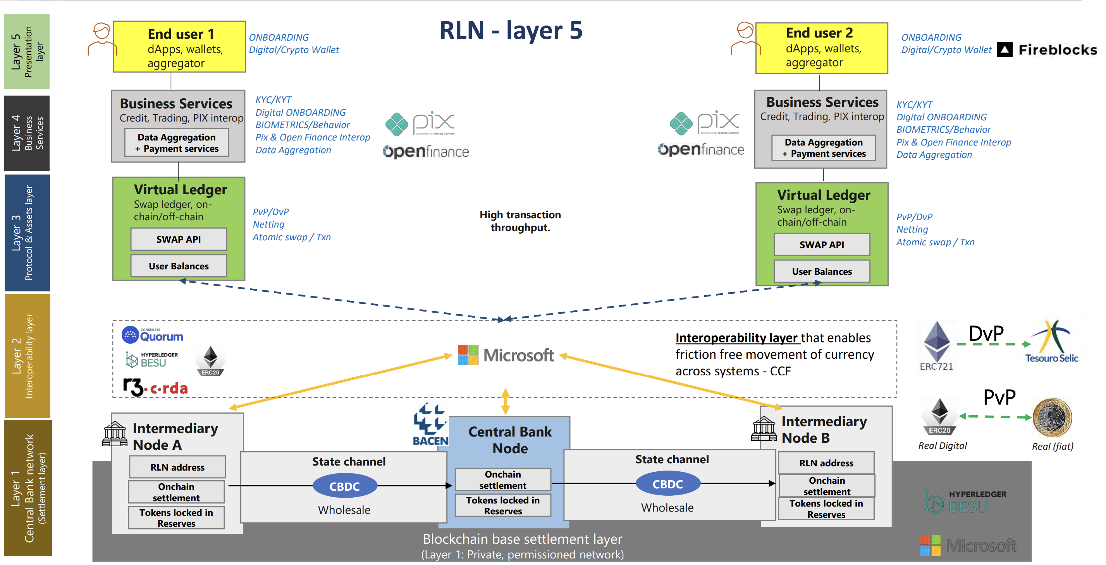
Architecture design of RLN
https://aprendervalor.bcb.gov.br/conteudo/eventos/Documents/moedas_digitais/tokenizacao/WorkTOK-Multi_B_APRESENTACAO_Proposal_RLN_architecture_to_support.pdf

Slide 15
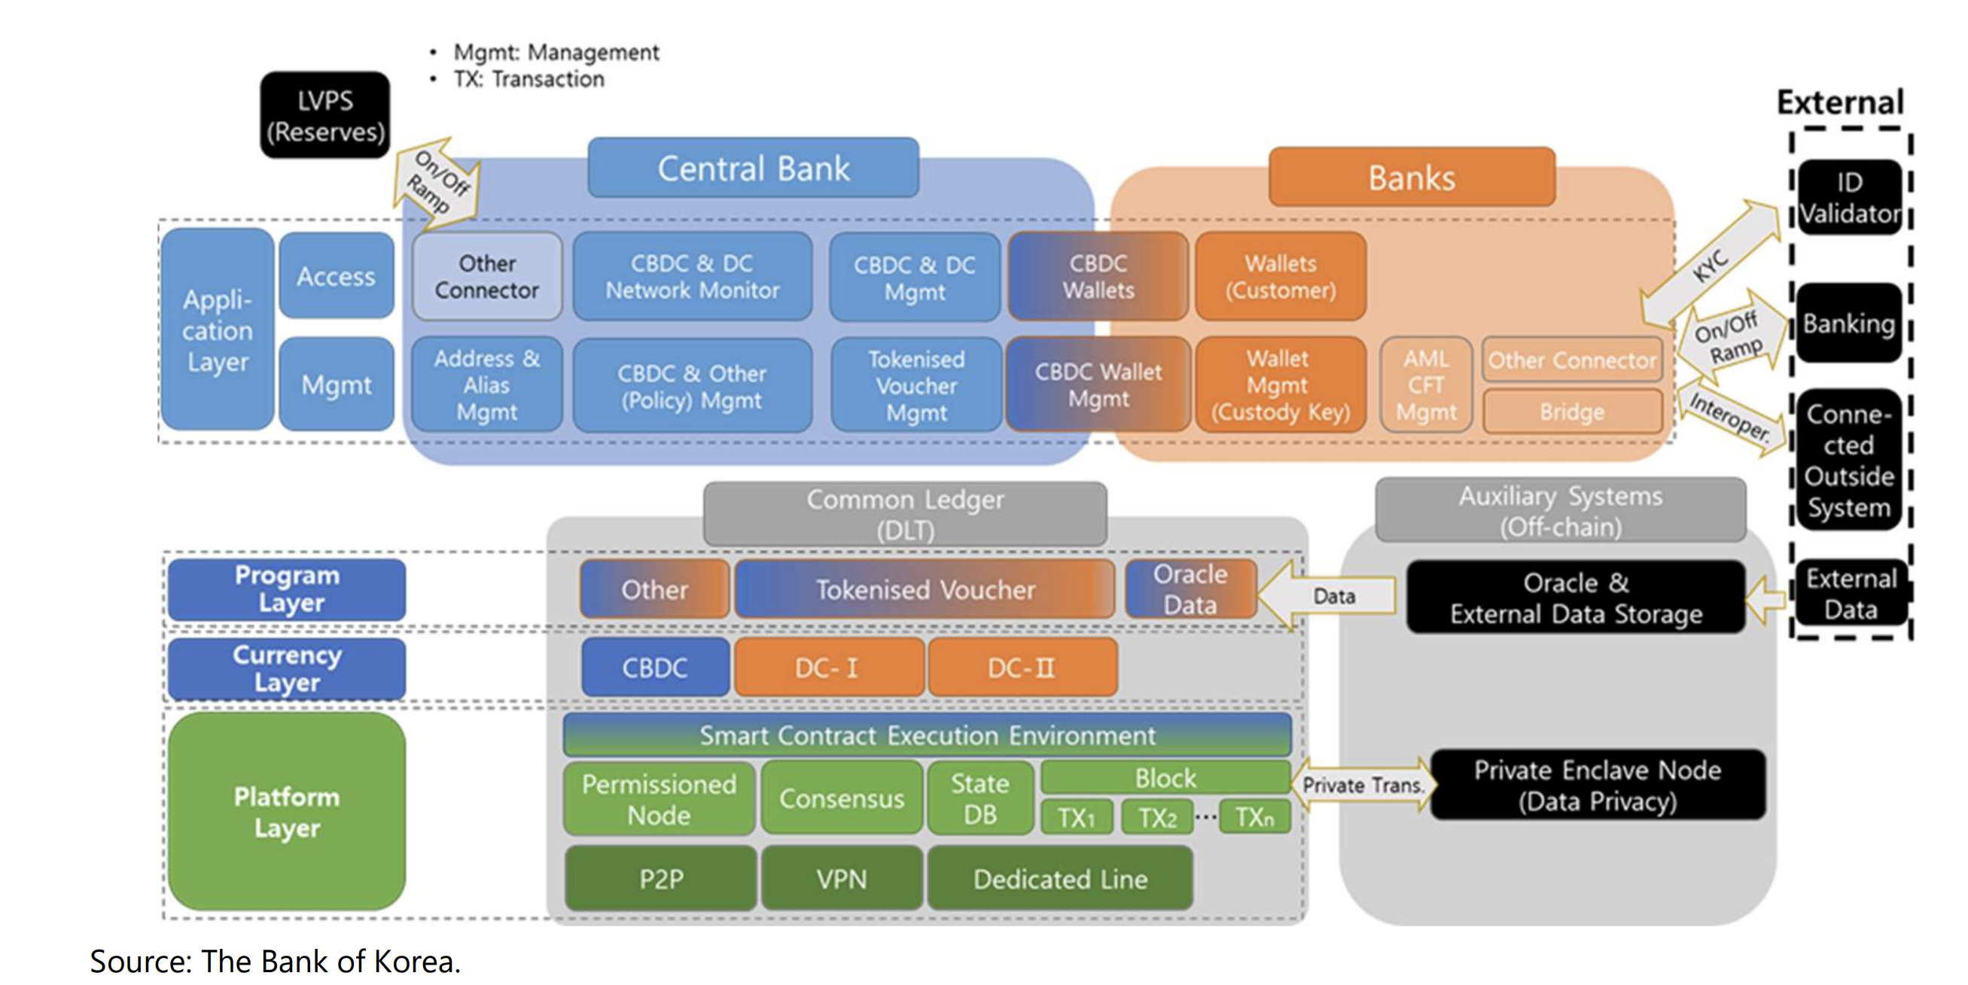
Building block of RLN

Slide 16
Building block of RLN

Slide 17
Clear Choice of DLT technology

Slide 18
XDC Key Fact Sheet
NAME
Governance
Founding date
HQ
Type
Access
Consensus
SC Language
Claimed TPS
Currency
Ethereum
Ethereum Foundation
2014
Switzerland
Blockchain
Permissionless
PoW/ PoS
Solidity
20
ETH
Hyperledger Fabric
Linux Foundation
2015
United States
Blockchain + DLT
Permissioned
Order of Txn with RAFT validators
GO/ Java/ Node.js
2000
N/A
Corda
R3
2014
United States
DLT
Permissioned
UTXO with custom validators
GO/ Java/ Node.js
200
N/A
Quorum
Consensys
2017
United States
Blockchain + DLT
Permissioned
RAFT, PoA/ PoW
Solidity
100
N/A
XDC Network
XinFin
2019
Singapore
Blockchain
Permissionless + Permissioned
XDPoS since 2Dec2021
Solidity
2000
XDC
About FORMS

Slide 19
XDC Feature Commentary
XDC Strength
Strength of Consensus
Adoption of ISO20022
Support for Trade Finance Application
2000 TPS
Benefits from ETH smart contracts
XDC Claims
XinFin XDPoS relies on a system of 108 Masternodes with to support low transaction fees and 2-second transaction confirmation times. Stability and chain finality are guaranteed via double validation, staking via smart-contracts and true randomization processes. ⁽¹⁾
XinFin Private Network lets any kind of enterprises connect their legacy systems with XDC Network using the XDC Protocol and messaging compatible with ISO20022 standard. ⁽²⁾
Tokenisations of asset, invoice factoring and financing and contract tracing, leveraging public and private Blockchain
XinFin has claimed this statistics through different publication. No relevant test results have been published.
XinFin is fully EVM-compatible, all ETH smart contract can be deployed and run on Ethereum network.
Our Comments
DPoS is also adopted in some other blockchain network e.g. Tron, EOS. They have contributed new ideas in the consensus. However, the XDC foundation is owning most of the validators which violates the original idea of DeFi.
XinFin didn’t provide any code repository and smart contract templates which have adopted ISO20022 standard.
TradeFinex platform functions are inaccessible due to development. Functions such as invoicing is at POC stage for users testing.
XinFin is underutilised and has no sufficient transactions to ender TPS figure, but we have also found that DPoS from TRON offers the same performance for 2000 TPS.
XinFin is forked from ETH, XDC shares the same EVM and also all ETH account structure. Existing ETH wallet can be used on XDC network as long as the wallet owner switches the network ID.
About FORMS
Notes:
(1) https://www.xinfin.org/dpos_tech_brief
(2) https://xinfin.org/ISO20022

Slide 20

R3 Corda
Background
Founded in 2014 as banks, regulators, and technology consortium
Distributed Ledger Technology (DLT) that specializes in financial industry
Main focus is on facilitating the exchange of financial assets
World Bank & Commonwealth Bank of Australia (Bond-i)
Bond issuance platform to enable management and settlement of digital bonds.
SIX Digital Exchange (SDX)
Subsidiary of SIX Group, digital exchange for trading securities, including digitized bonds
Asian Development Bank (ADB)
Cross-border multi-currency securities settlement system in Asia
Monetary Authority of Singapore (Project Ubin)
Wholesale interbank CBDCs
HSBC, ING, SCB, etc. (Contour)
A trade finance platform that allows banks and corporate clients to manage trade transactions from initiation to settlement, issuance of letter of credit, management of trade documents and payment trackers
SBI Holdings
FX margin trading
Pros and Cons
Need-to-know basis privacy-enabling feature: only involved party knows the details of a transaction
Varieties of use cases including CBDC POC had been built atop
JVM-based infrastructures supported
Hard to scale up horizontally
Partnership
Use Cases
Wholesale CBDC (e.g .Project Ubin, Jasper)
Interbank Settlement and Cross Border Transfer
Digitalized Bonds (e.g. SDX, World Bank & Commonwealth Bank of Australia Bond-i)
Trade Finance (e.g. Contour, Marco Polo, Voltron, Komgo)
Securities Lending (e.g. HQLAx)

Slide 21
Hyperledger Fabric
Background
First released on 2017
Uses “Pluggable consensus” which developers can choose from a range of consensus algorithms
Adopted by large companies and organizations across different industries ranging from finance, healthcare, and supply chain management.
Maersk, IBM (TradeLens)
users can exchange trade and shipping data, the platform provides a single, shared view of the entire supply chain and real-time monitoring of cargos, goods movement
HSBC, Santander, etc (We.trade)
users can exchange trade and shipping data, the platform provides a single, shared view of the entire supply chain and real-time monitoring of goods movement
Government of Bermuda (Viant)
platform management of property title and deeds in the country
BNY Mellon, State Street, Deloitte (FundGuard)
investment funds tracking and management, risks management tools and portfolio optimizations
Sberbank
trade finance transactions, including exchanging letters of credit
Visa
B2B Connect payments platform
GSBN
Trade finance solution allows FI to leverage logistics data on chain
Pros and Cons
Channel architecture, creation of private channels within a network
Support multiple languages for smart contract programming
Relatively High throughput
Complicated Channel Setup
Partnership
Use Cases
Trade Finance (e.g. We.trade)
Supply Chain (e.g. Modum, Serai, TradeLens)
Insurance (e.g. B3i)
Physical asset-based properties (e.g. Viant)
Derivatives Trading (e.g. Project Dovetail)
Portfolio Management (e.g. FundGuard)

Slide 22
Hyperledger Besu
Background
Started in 2018 by Consensys as “Quorum”, later donated to the Hyperledger project in 2019
Enterprise focused features such as permissioned network and private transaction
Public Mint
Private to Public blockchain for users to use fiat on public blockchain through Besu
HKMA, BoT, CBUAE (mBridge)
wholesale CBDC PoC between Thailand, Hong Kong and UAE
South African Reserve Bank (Project Khokha)
Wholesale CBDC research in 2022
Bank of Israel (e-Shekel)
retail CBDC PoC on digital shekel in 2017
Norges Bank (Norway CBDC)
Retail CBDC PoC in 2022
OpenLaw
Platform to create legal agreements in smart contracts
Etherisc
A platform to build insurance products
Pros and Cons
Support different types of consensus and network configuration, e.g. Clique PoA, QBFT
Privacy-enabled feature: privacy groups
EVM-compatibility, dev-friendliness
Varieties of use cases enabled by smart contracts
Ability to connect to Ethereum mainnet
Low throughput for private transactions
Partnership
Use Cases
Wholesale CBDC (e.g. mBridge, Project Khokha)
Retail CBDC (e.g. e-shekel, Norway CBDC)
Notes:
https://etherisc.com

Slide 23
Regulated Liabilities Network (RLN)
Background
Tony McLaughlin in June 2021, Citi released paper “The Regulated Internet of Value”
A shared hierarchical ledger, which enables both central bank money and commercial bank money to be tokenized
Ambition of creating a global settlement network
Proof-of-Identity: Only authorised parties may contribute to the consensus process
Sandbox not accessible to public
SETL the company implemented RLN
Swift
Delivers interoperable tokens framework for SWIFT
Citi
Invested in SETL
As of 2021 they are in process of deploying their solutions within Securities Services business
Deloitte
Invested in SETL
HSBC, BNY Mellon, Wells Fargo, PNC Bank, TD Bank, Triust, US Bank, Mastercard
Involved in the 12-week trial of RLN in 2022, with the New York Fed Reserve on digital dollar payment for digital asset transactions
Pros and Cons
Instantaneous settlement potential
Global FI consortium: interoperability
1million TPS achieved on AWS server
Trusted network: participants must be known to gain access to the network
ISO20022 compliant
Partnership
Use Cases
Interbank Settlement and Cross Border Transfer
Wholesale and retail CBDCs (micropayments)
Digitized bond, physical asset-backed securities, STO
Trade Finance
Notes:
Citi - https://www.ledgerinsights.com/citi-backed-setl-open-sources-blockchain-interoperability-solution/
SETL - https://www2.deloitte.com/uk/en/pages/financial-services/articles/investing-in-blockchain-technology-with-SETL.html
Swift – https://setl.io/setl-delivers-interoperable-tokens-framework-for-swift-clearstream-and-global-custodians/

Slide 24
Ethereum (ETH)
Background
The network went live on 2015
It is a decentralized, open-source blockchain with smart contract functionality
Validator-based Proof of Stake consensus and a throughput of 27 TPS
Various dApps cause network congestion
Visa
Integrating the USDC into their platforms and send and receive USDC payments
Santander
Issued of the $20 million bond on Ethereum chain
Pros and Cons
Large developer community that easier to find support, documentation, and resources
One of the most famous blockchain locking more than 50% total value of virtual asset
Legacy ecosystem of dApps, tools, and services built on top of its network
Extremely low throughput and expensive gas
Uniswap
Token swap AMM
Aave
Crypto Lending
Partnership
Maker
Generation of DAI Stablecoin
Polymath
STO Issuance
Use Cases
Digitized bonds, physical asset backed properties (e.g. Polymath)
DID (e.g. ENS)
NFT (e.g. Opensea)
DeFi / Stablecoins
Lending (e.g. Aave)
Automatic Market Maker (e.g. Uniswap, Curve)
Stablecoin Issuance (e.g. USDC, USDT)
E-AUD on Layer2 solution
Ethereum Name Service (ENS)
register a human-readable name and associate it to an address
Yearn Finance
Yield Farming
CryptoPunk, Bored Ape Yacht Club
Notes:
Santander - https://www.santander.com/en/press-room/press-releases/santander-launches-the-first-end-to-end-blockchain-bond
Visa and USDC - https://www.forbes.com/sites/michaeldelcastillo/2020/12/02/visa-partners-with-ethereum-digital-dollar-startup-that-raised-271-million/?sh=20b3f3514b1f

Slide 25
Polygon (MATIC)
Background
Launched in 2017 and rebranded in 2021
Originally a Layer 2 scaling solution that allows developers to build decentralized applications on top of it
An EVM-based chain with 2 sec block time and 7000 TPS throughput
EY
Nightfall, privacy-based blockchain protocol
Stripe
USDC payments via Polygon to Twitter creators through Twitter event
Adobe
Acquired social media Platform Behance and will allow users to issue NFT using Polygon chain
Pros and Cons
Low fees
EVM-compatibility, dev-friendliness
High throughput comparing to EVM
Previous network outages which last for days
Frequent network congestions
Nubank (Brazil based Bank)
Nucoin customer loyalty programme
Mastercard
Web3-focused incubator to help artists connect with fans
Partnership
Project Guardian
Foreign exchange and government bond transactions against liquidity pools
Use Cases
Digitized bonds, physical asset backed properties, STO (e.g. INX.one)
NFT (e.g. Opensea)
DID (e.g. PNS)
Game and tokenomics (e.g. Planet IX)
DeFi / Stablecoin (e.g. USDC, USDT)
Hamilton Lane
Tokenized feeder fund on Securitize
Adidas for Prada
Issue NFT
Meta
Users on Instagram can Mint and Sell on Polygon Chain
Notes:
EY - https://www.ey.com/en_gl/news/2023/01/the-ey-and-polygon-organizations-update-source-code-for-blockchain-privacy-based-protocol-nightfall
Hamilton Lane - https://www.coindesk.com/business/2023/01/31/investment-manager-hamilton-lane-opens-first-tokenized-fund-with-securitize/
Stripe - https://stripe.com/blog/expanding-global-payouts-with-crypto
Nubank - https://thepaypers.com/cryptocurrencies/nubank-launches-its-own-cryptocurrency--1258812
Mastercard - https://polygon.technology/blog/mastercard-taps-polygon-for-web3-musical-artist-accelerator-program
Meta - https://polygon.technology/blog/meta-to-let-users-mint-and-sell-polygon-powered-nfts-on-instagram
Adobe - https://decrypt.co/94572/adobe-polygon-scale-nft-functionality-behance-social-platform
Adidas for Prada - https://opensea.io/collection/adidas-for-prada-re-source

Slide 26
Ripple (XRP)
Background
Stable released since 2018
RippleNet is a real-time gross settlement system, launched for institutional use and claimed to be compliant to ISO20022, using the native token, XRP as settlement currency
XRP was engaged into a lawsuit by SEC in 2020, over the definition of XRP as a security.
Santander
Cross-border Payment
Royal Monetary Authority of Bhutan
Retail, cross-border and wholesale CBDC
Pros and Cons
High throughput, low fees
Compliant to ISO20022
Upcoming potential smart contract capabilities
Smart Contract capabilities in development
SEC alleges Ripple XRP token as securities and they are in
Siam Commercial Bank
Cross-border Payment using SCB ‘s Easy app
Partnership
Partnership
Republic of Palau
Cross-border payments and a USD-backed digital currency
Use Cases
Interbank / cross-border transfer (RippleNet)
CBDC (RippleNet)
Canadian Imperial Bank of Commerce (CIBC)
Cross-border Payment
Notes:
https://ripple.com/customer-case-study/
https://ripple.com/customer-case-study/scb
https://aws.amazon.com/partners/success/ripple/
https://www.coindesk.com/learn/what-is-ripple-and-the-xrp-cryptocurrency/
https://ripple.com/insights/bhutan-advances-financial-inclusion-and-sustainability-with-ripples-cbdc-solution/
https://ripple.com/insights/featured/republic-of-palau-partners-with-ripple-to-develop-digital-currency-strategy/

Slide 27
Avalanche (AVAX)
Background
Released in 2020
2 sec block time and 4500 TPS throughput
Three-chain structure:
C-chain: EVM solidity smart contract execution layer
P-chain: validators, subnet operations
X-chain: native token (AVAX) operations (e.g. trading)
Private/Permissioned subnet using Primary Network validators agreeing to run the same Virtual Machines (VM) with its own rules
Mastercard
Startup engagement program
Tencent Cloud
Technical support to developers and projects for deploying nodes rapidly on Tencent's cloud infrastructure
AWS
Support Avalanche’s infrastructure and decentralized application (dApp) ecosystem, alongside one-click node deployments, through its marketplace
Pros and Cons
High throughput, low fees
Great venture networks
EVM-compatibility, dev-friendliness
STO capabilities and potentials
Native privacy group
Rare service outage, however this is a new chain
Deloitte
Improve security, speed and accuracy of Federal Emergency Management Agency reimbursements
Partnership
Partnership
Securitize
Security tokens issuing platform tokenized KKR's Health Care Strategic Growth Fund II
Use Cases
Digitized bonds, physical asset backed properties (e.g. Securitize, DEFYCA)
NFT (e.g. Opensea)
DeFi / Stablecoins
Automatic Market Maker (e.g. Trader Joe)
Stablecoins (e.g. USDC, USDT)
Security Token
DEFYCA
Private Debt Market
INX
Regulated digital securities and cryptocurrency trading platform
Notes:
Mastercard - https://medium.com/avalancheavax/ava-labs-selected-for-mastercard-start-path-program-to-open-new-opportunities-and-solve-real-world-bc29313837aa
AWS - https://techcrunch.com/2023/01/11/aws-partners-with-avalanche-to-scale-blockchain-solutions-for-enterprises-governments/
Tencent Cloud - https://medium.com/avalancheavax/ava-labs-and-tencent-cloud-enable-rapid-node-deployment-on-the-avalanche-public-blockchain-across-751ffb6801eb
Deloitte - https://www2.deloitte.com/us/en/pages/about-deloitte/articles/press-releases/deloitte-ava-labs-blockchain-state-local-government-natural-disaster-recovery.html
Securitize - https://securitize.io/press-releases/securitize-becomes-first-security-token-platform-to-integrate-with-avalanche-blockchain-platform
DEFYCA - https://www.coindesk.com/markets/2023/03/09/securities-platform-defyca-to-release-tokenized-private-debt-protocol-on-avalanche/

Slide 28
Polkadot (DOT)
Background
Released in 2020
A protocol that connects blockchains (parachains)
Allowing value and data to be sent across previously incompatible networks
Parachain
Astar
Sony
Shibuya City
Polymesh
Shinhan Securities Ltd
Stably
Polymesh
Security Token Offering
Moonbeam
Full EVM-compatibility with high throughput and low fees
Pros and Cons
High throughput, low fees
Projects owns their blockchain while sharing Polkadot's pooled security
Parachains are inherently interoperable, making it easier to bridge assets over different parachain networks
Poor Documentation
Small developer pool
Partnership
Revolut
Virtual Bank
Use Cases
Digitized bonds, physical asset backed properties, STO (e.g. Polymesh)
DeFi / Stablecoins
Automatic Market Maker (e.g. Acala)
Stablecoins (e.g. aUSD)
Notes:
Revolut
https://www.finextra.com/pressarticle/95992/revolut-launches-polkadot-learn--earn-course-on-staking
Astar
https://medium.com/astar-network/astar-partners-with-shibuya-city-6824712020da
https://medium.com/astar-network/web3-incubation-program-by-sony-network-communications-and-astar-4d5766ba3ea6
Polymesh
https://www.prnewswire.com/news-releases/stably-and-polymesh-exploring-issuance-of-us-dollar-backed-stablecoin-usds-on-polymesh-301615072.html
https://cryptotvplus.com/2023/02/how-south-korea-is-developing-a-digital-asset-roadmap/

Slide 29
Arbitrum/Optimism (ARB/OP)
Background
Released in 2022 and 2023 respectively
Rollup mechanism bundling transactions from L2 to a single transaction, and relay back to the Ethereum L1 mainnet after validations
New protocols.
No FI partnership at the moment
Pros and Cons
High throughput, low fees
Security inherited from Ethereum consensus
Too young
Not much Flagship projects
Partnership
Uniswap
Token swap AMM
Use Cases
DeFi / Stablecoins
Crypto Lending (e.g. Aave)
Automatic Market Making (e.g. Uniswap)
NFT (e.g. Opensea)
Aave
Crypto Lending and Borrowing
Notes:
Official layer 2

Slide 30
Solana (SOL)
Background
Founded in 2020
a blockchain network built for running smart contract-based applications.
Google Cloud
will eventually become Solana node validator and start indexing on Solana blocks, enabling flexibility and accessibility to developers on historical data.
Infrastructure
Pros and Cons
Krafton
the company behind the popular battle-royale PUBG, announced partnerships with Solana Labs on developing game that allows players to earn NFT in-game items, fostering play-to-earn economy.
High throughput, low fees
Strong advocacy for developers
Ease of use for Phantom Wallet
Frequent blockchain service outage
No Privacy solution
Game-Fi
Partnership
Use Cases
DeFi / Stablecoins
Stablecoins (e.g. USDC, USDT)
Automatic Market Maker (e.g. Raydium)
NFT (e.g. Magic Eden, Opensea)
Game and tokenomics (e.g. walk-to-earn STEPN)
Meta, Instagram
NFT profiles integrations with Solana blockchain
Opensea integration
NFT
Notes:
Google - https://cointelegraph.com/news/solana-unveils-google-partnership-smartphones-web3-store-at-breakpoint
Krafton - https://krafton.com/en/news/press/krafton-inc-signs-long-term-cooperation-agreement-with-solana-labs-for-blockchain-based-games-and-services/

Slide 31
Binance Smart Chain (BNB)
Background
Swipe
utilize crypto payment, supports on/off ramp fiat-crypto conversions.
Enabled access to ApplePay, Google Pay and Samsung Pay.
Simplex
crypto-to-credit card payment infrastructure.
Claimed to have supported 200+ cryptocurrencies and 100+ fiat currencies with 350+ strategic partnerships.
Launched in 2017 as BNB chain and rebranded in 2020
EVM-compatible
Built using Cosmos SDK
Payment
Pros and Cons
Low fees
Versatile ecosystems
EVM-compaibility, dev-friendliness
Binance And Venture capitals connections
Token bridges readily available
Listing opportunities on the Binance exchange
Frequent network congestions
In allegation from CFTC of selling unregistered securities, assisting customers skirt KYC
Partnership
Animoca Brands
A metaverse on Ethereum, enabling users to create, buy and sell their NFTs.
Gaming
Use Cases
DeFi / Stablecoins
Automatic Market Maker (e.g. PancakeSwap, Cream Finance)
Crypto Lending (e.g. Venus)
Crypto Payment (e.g. Swipe, Simplex)
NFT (e.g. Opensea)
Game and tokenomics (e.g. Cryptoblades)
Chainalysis
Providing real-time monitoring over blockchain networks.
CipherTrace
AML engines on “identifications of high-risk addresses” and Dapps monitoring.
Compliance
Notes:
Swipe - https://www.binance.com/en/blog/all/binance-and-swipe-partner-to-bridge-crypto-and-commerce-announce-acquisition--421499824684900723
Simplex - https://www.simplex.com/simplex-and-featured-by-binance#:~:text=Simplex%2C%20a%20Nuvei%20company%20and,innovation%20in%20the%20crypto%20ecosystem.
Animoca - https://www.animocabrands.com/partners-with-binance-smart-chain

Slide 32
Fantom (FTM)
Background
Founded in 2018
Decentralized, permissionless, open-source smart contract platform for decentralized applications (dApps) and digital assets
Pros and Cons
Versatile DeFi ecosystems, quick innovations
Low fee
Founded by Andre Cronje, creator of Yearn Finance, a legacy DeFi application
A specific branding chain being used only for DeFi
No FI partnerships at the moment
Mainly with crypto related companies
Partnership
Use Cases
DeFi / Stablecoin
Stablecoins (e.g. Magic Internet Money)
Yield Farming (e.g. Abracadabra)
Lending (e.g. SpookySwap)

Slide 33
Cosmos (ATOM)
Background
Established in 2016
It is an ever-expanding ecosystem of interoperable and sovereign blockchain apps and services
Cosmos uses a bridge-hub model that connects Tendermint chains
Binance, Crypto.com, Secret Network
Built their Blockchain using Cosmos SDK
Pros and Cons
High throughput, low fees
Ease of creating blockchains using Cosmos SDK
Privacy-enabling features
Inter-blockchain communication (IBC)
Blockchains build using Cosmos SDK can communicate and transfer tokens
New languages and SDK
Frequent smart contract hacks
Osmosis
Decentralized Cosmos exchange for interchain assets
Partnership
Use Cases
Create Blockchain using its SDK
Notes:
https://blog.cosmos.network/understanding-the-value-proposition-of-cosmos-ecaef63350d
Cosmos uses a bridge-hub model that connects Tendermint chains

